Slide 1
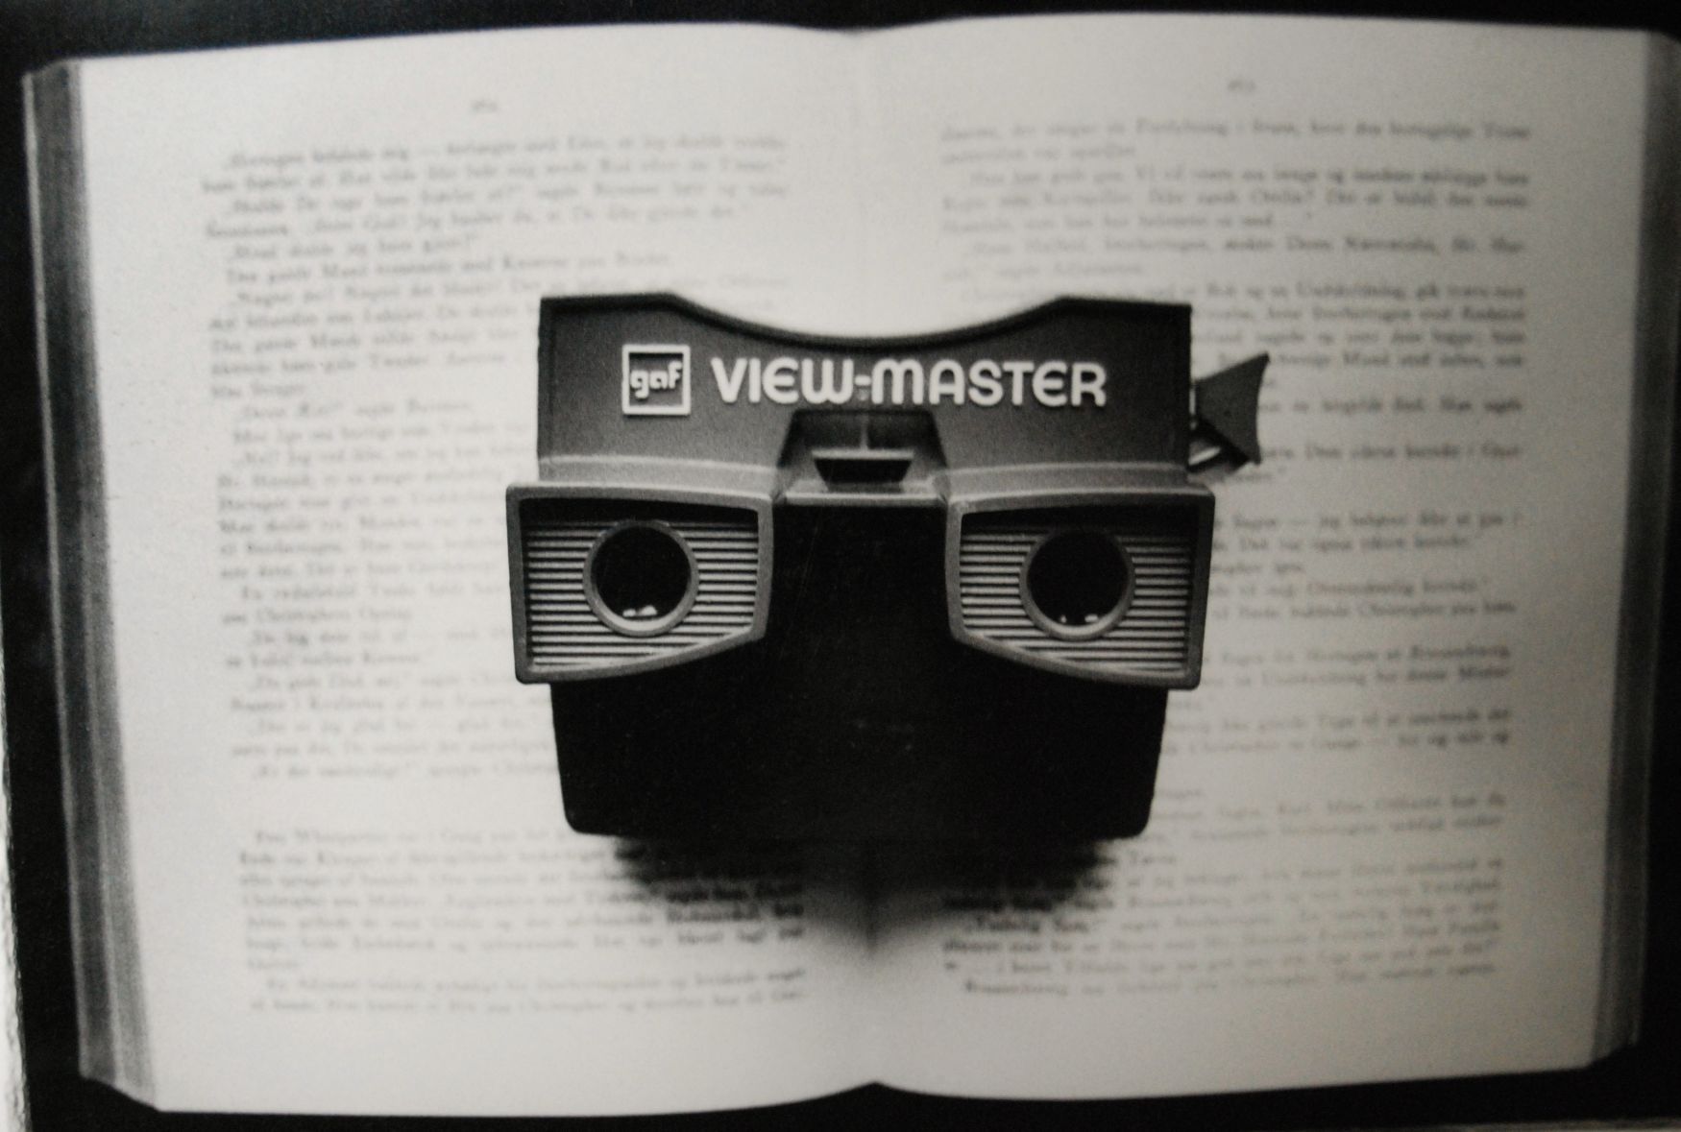
The Multimodal Essay
Presented
By:
Kristin Bradley
TA Department of English and Journalism

Slide 2
Multimodal Essays
Definition(s):
A single product comprised of two or more media types
A multi component project with each component composed in a different media.
Using multiple modes or forms to deliver or make your point.

Slide 3
More Multimodal
Multimodal documents can combine text, image, animation, sound, and video. These types of essays vary greatly in form.
For example a multimodal essay could be created in Microsoft Word integrating images, photos, text formatting and graphs or charts.
Or could be created in Power Point and be a series of slides that integrate text, image and animation (like this presentation!)

Slide 4
My Application
I based my classroom approach after Karen Moynihan
I adapted her timeline and project to fit with the WIU English 180 Paper 4 (Problem Essay) and Paper 5 (Researched Argument Essay).
I required my students to do multimodal research AND insert multimodal elements into basic Microsoft Word Documents.

Slide 5
Getting Started with Content
I had the content of Paper 4 be part of the content for Paper 5 so the students could get practice “integrating” content.
This was done students could see and apply content of papers together and because I was asking them to do outside elements (graph, primary research, design of paper and images) I wanted them to feel comfortable that they had some of the content already done.
This did not mean that they simply had half their paper done and they could just start typing on the end of Paper 4.
They had to take the problem they discussed and turn it into a well-developed researched argument. This was an important continuation of practice with ORGANIZATION.
Notes:
This was done students could see and apply content of papers together and because I was asking them to do outside elements (graph, primary research, design of paper and images) I wanted them to feel comfortable that they had some of the content already done.
However, this did not mean that they simply had half their paper done and they could just start typing on the end of Paper 4.

Slide 6
Multimodal Vehicle: Media
I chose to use Microsoft Word as the vehicle of the multimodal elements for a couple reasons:
1. Semester time constraints. Adapting the time line from Moynihan’s approach into one that would fit my classroom was a challenge. I left out some of the aspects Moynihan incorporated in her classroom approach.
2. Familiarity. Most students were already familiar with the program.
In the future I hope to move to other media types such as Power Point, Slide Share and Web Pages.

Slide 7
Multimodal Research
Students were required to do both secondary and primary research.
Primary Research: Conducting Interviews
Secondary Research: Included Scholarly Journal Articles, Book/print sources and Web sources
I required my students to physically bring their book source to class so I could approve them.

Slide 8
Conducting Interviews
I gave the students a lesson on interviews/etiquette.
I provided interview tips in handouts and gave class time to brainstorming questions and approaches.
My students had to formulate and turn in typed documents with potential interview questions and they also had to type transcripts of their interviews for me to read before they incorporated the information into
their final paper.
They were free to interview via face-to-face, phone,
e-mail or social media like Facebook and Twitter.

Slide 9
Images, Design, Graph/Chart
My students were required to insert at least 2 images into their document and connect the images to the appeals ethos, pathos and logos.
Students provided a label/caption underneath each image providing a correct citation (Image Copyright) AND label which argument appeal (ethos, pathos, logos) their image(s) supported.
Include Design (headings, fonts, color, layout) in their paper. I showed them some examples in class.
They also inserted a graph/chart that depicted found data on their topic. They had to create this themselves they could not copy one that was already made.

Slide 10
Checklist for Multimodal Essays
Consistent Design
Readable Headings and Body
Appropriate use of Color
Illustrations are labeled and near relevant passages
If used, animation and sound are supporting the document not distracting

Slide 11
Rewards of Teaching MultiModal Approach
Students rise to the challenges.
Personally rewarding (Graphs/Data/Interviews) Pleasure of creativity: It feels good to be creative! (Design of documents)
Engages students even further with sources, research process and writing process they are having to spend more time figuring out how to include, make and analyzing and evaluating IF the elements are supporting their argument/text.
Helps students view writing as a “deeper” process that involves multiple elements text and image.

Slide 12
Multimodal Composition Challenges
We [instructors] become “learners” in areas when we are accustomed to being “experts”
Incorporate multimodal elements into classroom (scaffolding prior knowledge and experience) while trying to learn the technology and visual literacy side (how the visual layout of a page can promote/support meaning).
Time Lines/Due dates and keeping students on track. They have a lot to remember!

Slide 13
More Challenges
Challenge to pair “old” new media (basic Microsoft Word paper) with “new” new media (image, audio, video) but I have found that this integration is the best way to introduce the students to this type of composition.
It can be exploratory and open ended….at times I have felt ‘unsure” and “uneasy” that students were understanding and headed in the right direction. But despite that, I have learned to be more “open” and have been so encouraged to see the process unfold.

Slide 14
More Challenges
Grading! Some might say they could not grade this type of essay since they are not “experts” on visual layout or technology….so I say then don’t “grade” them. At least not in the traditional sense of the term grading. Present clear expectations to your students perhaps in the form of a rubric or assignment grading criteria and stick to those established criteria when grading.
I also suggest grading on the aspects that you KNOW and are comfortable in grading. So grade the multimodal elements not on how well they are visually designed (unless you are comfortable and familiar with this type of evaluation) but rather ask do they fulfill their function? Do they SUPPORT the text? This is a typical question asked of source material and one my students have more easily understood.

Slide 15
Examples/Resources
http://sscenglishdept.wikispaces.com/AV+Examples
http://www.capella.edu/interactivemedia/onlinewritingcenter/downloads/theWritingProcess.pdf (page 24)
http://writinginweb20.wetpaint.com/page/Integrating+Visuals+with+Text
http://owl.english.purdue.edu/owl/resource/691/01/
http://eng102branscomb.wikispaces.com/Multimodal+Essay
http://twp.duke.edu/uploads/assets/Using%20Visual%20Rhetoric%20in%20Academic%20Writing.pdf
http://wiz.cath.vt.edu/tw/TechnicalWriting/docdesign/visuals.htm

Slide 16
Examples/Resources
1. From the Purdue Owl: Visual Rhetoric Slide Presentation http://owl.english.purdue.edu/owl/resource/729/01/
2.From Oklahoma State University Writing Center: Effectively Incorporating Visuals into Your Documents: Purdue OWL

Slide 17
Syllabus Time Line Example
Wed., Oct. 31: Lab | Lesson: Writing to Convince/Persuade Discussion: JC Chapter 10/ Paper 5 Final Project Assignment Sheet | Read: Paper 5/Final Project Assignment Sheet available on WO, JC Chapter 10 pgs:404-405 and JC Chapter 18 pgs: 608 (from multimodal essay) -611
Fri., Nov. 2: Class | Lesson: Multimodal Essay Discussion: JC Chapter 6 Interviews and Field Research and Chapter 18 Designing Your Document/Finish Paper 5 Final Project Assignment Sheet | Read: JC Chapter 6 pgs: 186-188, look at JC Chapter 18 pgs: 596-604, look at JC Chapter 7 pgs multimedia presentation 220-224
Mon., Nov. 5: Lab | Lesson: Writing to Convince/Persuade Discussion: Ethos, Pathos and Logos | Due: Annotated Bibliography on WO by 11:59 p.m.

Slide 18
Syllabus Time Line Example
Wed., Nov. 7: Class | Lesson: JC Chapter 10/ TREE Discussion: TREE (Thesis, Reasons, Evidence and Explanation) WJ Activity: Practice Outlining Paper 5 | Read: JC Chapter 10 pgs: 421-423 Due: Questions over reading JC pgs: 423-424
Fri., Nov. 9: Lab | START: Lesson: Integrating Visuals/Searching for Images/Image Copyright/Citation Discussion: Integrating Visuals Designing your Multimodal Essay Activity: Inserting Images
Mon., Nov. 12: Class | Lesson: Oppositional Claims Discussion: WJ Activity: | Read: JC pages 574, 434 and 442 Due: Book Source for Paper 5! Bring to Class

Slide 19
Syllabus Time Line Example
Wed., Nov. 14: Lab | CONTINUED: Lesson: Graphic Design Data Graphs Discussion: Designing your Multimodal Essay Activity: Practice Graph Designs, Brainstorm possible Graph/Data topics | Due: 2 Potential Images for Paper 5
Fri., Nov. 16: Class | Lesson: Combining Genres Discussion: How Papers 1-4 work together to make elements of Paper 5 Activity: Cut and Paste with Papers 1-4 | Due: Bring printed copies of papers 1-4
Nov. 19-Nov. 23 | Do your field research/interview/works cited if you have not and eat lots of turkey and pumpkin pie!! | Thanksgiving Break: No Class

Slide 20
Syllabus Time Line Example
Mon., Nov. 26: Lab | Work Day ☺ Paper 5 Content Insert graphs into paper using data you bring to class | Due: Field Research/Interview and Graph Research Data Come PREPARED to Draft Content of Paper 5
Wed., Nov. 28: Class | Conferences | Class Canceled for Conferences: Bring a typed, printed copy of your Paper 5 draft
Fri., Nov. 30: Lab | Conferences | Class Canceled for Conferences: Bring a typed, printed copy of your Paper 5 draft
Mon., Dec. 3: Class | Peer Review Workshop | Peer Review Workshop Due: Complete draft of Paper 5 upload to WO E-Portfolio
Wed., Dec. 5: Lab | Discuss: Global Level Revisions Assignment Sheet Activity: Work Day ☺ Wrap Up Paper 5 and/or Start Revisions to Papers 1-4 | Due: Final Draft of Paper 5 due on WO by 11:59 p.m.

Slide 21
The End
I hope this presentation was informative and helps give you some ideas to incorporate into your classrooms in the future.
Thank you for attending this workshop!

Slide 22
Image Credits
“Open Book Series: View Finder” by Kristin Bradley
“Bleistift” by Oliver Tacke CC BY 2.0
https://www.flickr.com/photos/otacke/10034140595/in/set-72157636077428096/
Pencil.jpeg
“Gluehbirne by Oliver Tacke CC BY 2.0
https://www.flickr.com/photos/otacke/10034100664/in/set-72157636077428096/
Lightbulb.jpeg
“Checklist” by Oliver Tacke CC BY 2.0
https://www.flickr.com/photos/otacke/12221292503
Checklist.jpeg
“Feedback checklist” by AJ Cann CC BY-SA 2.0
https://www.flickr.com/photos/ajc1/9568156463
Feedback.jpeg
“orange checkmark” by Wonderlane CC BY 2.0
https://www.flickr.com/photos/wonderlane/5203714378
Checkmark.jpeg

